Slide 1
WHAT IS METAVERSE?

Slide 2

Hello!
I AM Hussain Burhanuddin
I am here to present on the topic “Metaverse” and to make you understand this technology.

Slide 3
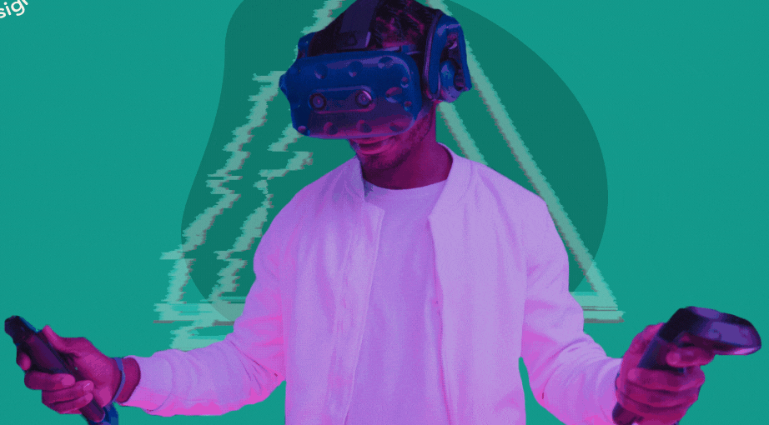
INTRODUCTION
1
An Explanation for People Who Don’t Get It.

Slide 4
The metaverse is a 3D version of the Internet and computing at large.

Slide 5

WHAT EXACTLY IS THE METAVERSE?
Talking about the metaverse feels a lot like talking about the internet back in the 70s and the 80s.
As the building blocks of the new form of communication were being laid down, it sparked speculation around what it would look like and how people would use it.

Slide 6

WHAT EXACTLY IS THE METAVERSE?
Many experts look at the metaverse as a 3D model of the internet.
Basically, a place parallel to the physical world, where you spend your digital life.
A place where you and other people have an avatar, and you interact with them through their avatars.
Some also argue that the metaverse in the truest sense of the term doesn’t actually exist yet.

Slide 7
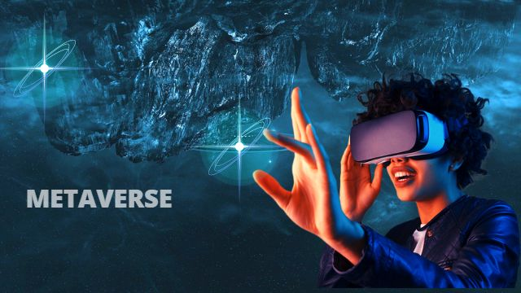
WHAT EXACTLY IS THE METAVERSE?
While the discourse on defining the metaverse differs from case to case, it is, in the simplest terms, a shared virtual space that is interactive, immersive and hyper-realistic.
It would also include your own customized avatar and digital assets, which will likely be recorded on a blockchain.

Slide 8

VIRTUAL REALITY
2
It’s not just a game?

Slide 9
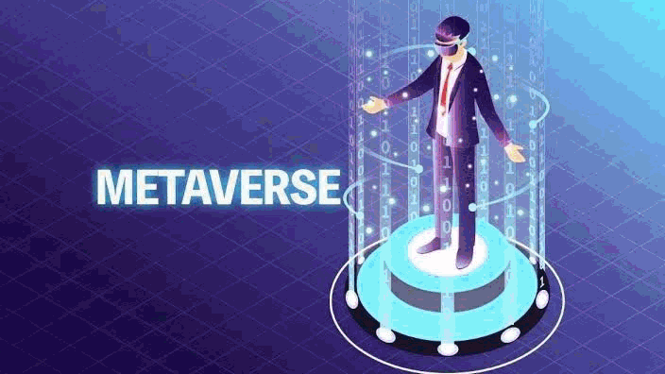
IT’S NOT JUST A GAME?
According to technologists, the metaverse will take the virtual reality experience to the next level, allowing users to float into the virtual world to do everything from buy land and host parties to even get married through digital avatars.

Slide 10

IT’S NOT JUST A GAME?
FORTNITE
Take for instance an online shooter game like Fortnite, where users have a personal avatar to engage and interact with other players' avatars, while also earning virtual currency to unlock outfits for their avatar.

Slide 11

IT’S NOT JUST A GAME?
SECOND LIFE
Perhaps the closest existing iteration to the envisioned metaverse is the game Second Life, a simulation game that lets users experience virtual reality in which their avatar could shop, eat, shower, and do everything they would in real life.

Slide 12
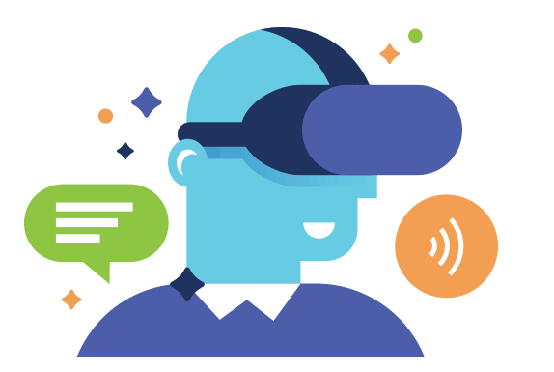
PLATFORMS
3
How do I access the metaverse for now?

Slide 13


HOW DO I ACCESS THE METAVERSE FOR NOW?
While there is no single gateway to access the metaverse at this point, experts suggest acquiring some hardware to truly immerse yourself in the experience.
In turn, this has led to multiple tech heavyweights offering a variety of experiences, from gaming and virtual workspaces to live entertainment and real estate. This includes platforms like Decentraland, Axie Infinity, Horizon, Sandbox, Fortnite and Roblox.

Slide 14
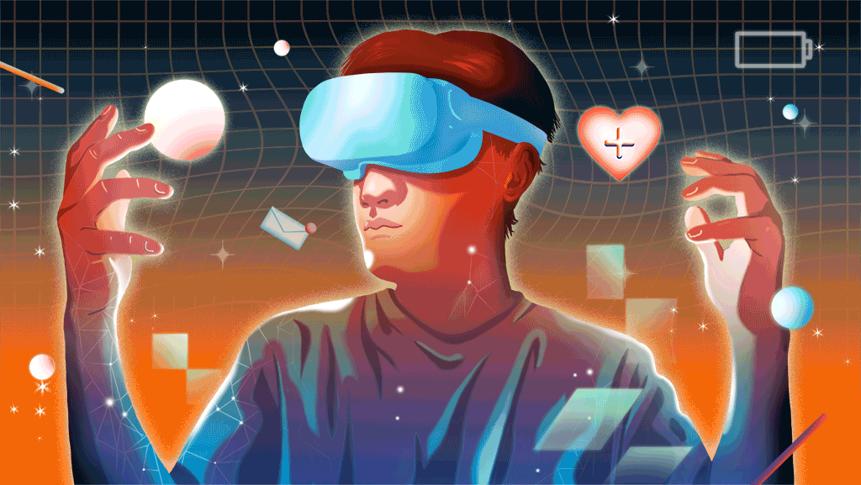
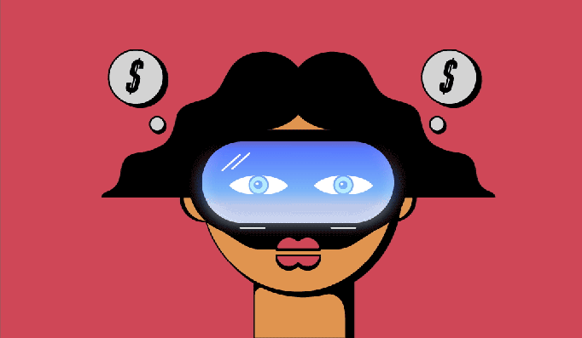
HOW DO I ACCESS THE METAVERSE FOR NOW?
However, many experts also argue that you don’t necessarily need a VR headset to get into the metaverse.
We’ll access the metaverse via a smartphone, but we will often be passively in it. There are hundreds of millions of people accessing real-time rendered 3D virtual worlds each day via tablets and smartphones. In a decade, it’s likely these devices will remain the primary way we access the metaverse.

Slide 15
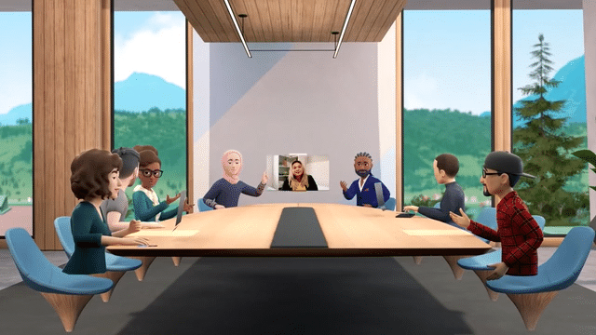
BENEFITS
4
What is the use of the Metaverse, really?

Slide 16
WHAT IS THE USE OF THE METAVERSE, REALLY?
The metaverse will grow the digital economy, which is the primary growth driver of the world economy.
But while the metaverse is already being seen as the future of entertainment, fashion, gaming and even partying, experts argue that its best-case use will likely be for education.
Just like how you'd understand dissection much better by actually performing it rather than just reading about it, 3D-based education is likely to be much better than, say, schooling over Zoom.

Slide 17

WHAT IS THE USE OF THE METAVERSE, REALLY?
Buying virtual countries that don’t exist in the real world could be an investment opportunity for making a quick buck, but the real value of the metaverse is when it’ll be used in ways that bring value to people’s lives.
So while there are scenarios where the technology and implementation can be useful – such as an augmented reality setup to train car mechanics or to help someone remotely fix an elevator they are stuck in – it still needs some work.

Slide 18

RISKS
5
Is it safe to be in the Metaverse?

Slide 19
IS IT SAFE TO BE IN THE METAVERSE?
Digital privacy experts also continue to point out that the metaverse would be the ultimate surveillance tool.
Not only would the metaverse collect data on your eye-tracking movement, hand movements, the shape of your room and more.
We also have to figure out a legal framework of what happens if you get harassed in a virtual platform, given that it has real implications since you’re so immersed in the technology.

Slide 20


IS IT SAFE TO BE IN THE METAVERSE?
The metaverse, he added, presupposes an implicit trust in technology, the way we rely on Google Maps for directions even if we’re never really sure whether it will lead us to the right destination.
There’s all this legal stuff we have to think about and actively pursued if we want to responsibly develop these technologies.

Slide 21

FUTURE
6
Will I be living in the Metaverse some years from now?

Slide 22

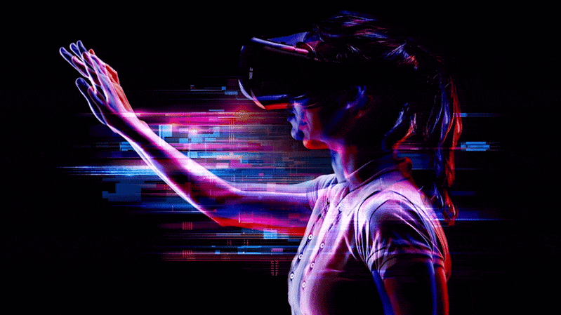
WILL WE BE LIVING IN THE METAVERSE SOME YEARS FROM NOW?
Some experts believe a large proportion of people will be in the metaverse in some way by 2030.
Perhaps we’ll live in the metaverse intermittently – we enjoy putting on VR goggles but don’t keep them on for very long.
Or, maybe, we’ll laugh at this VICE article a decade from now, thinking how naive people were to have questioned the rise of the metaverse.

Slide 23

THANK YOU!
Any Questions?

